Slide 1
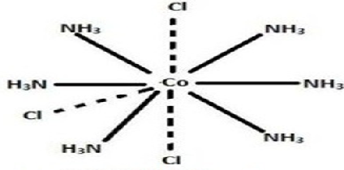
NOMENCLATURE
COORDINATION COMPOUND

Slide 2
Name the ligands first, in alphabetical order, then the metal atom or ion.
Note: The metal atom or ion is written before the ligands in the chemical formula.

Slide 3
For anionic ligands end in "-o"; for anions that end in
"-ide"(e.g. chloride), "-ate“ (e.g. sulfate, nitrate),
and "-ite" (e.g. nirite), change the endings as follows:
-ide -o; -ate -ato; -ite -ito
For neutral ligands, the common name of the
molecule is used.
e.g. H₂NCH₂CH₂NH₂ (ethylenediamine).
Important exceptions: water is called ‘aqua’,
ammonia is called ‘ammine’,
carbon monoxide is called ‘carbonyl’, and the
N₂ and O₂ are called ‘dinitrogen’ and ‘dioxygen’.

Slide 4
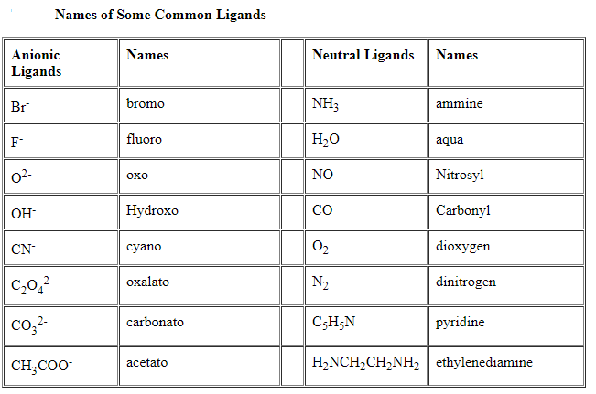

Slide 5
Greek prefixes are used to designate the number of each type of ligand in the complex ion, e.g. di-, tri- and tetra-.
If the ligand already contains a Greek prefix (e.g. ethylenediamine) or if it is polydentate ligands (ie. can attach at more than one binding site) the prefixes bis-, tris-, tetrakis-, pentakis-, are used instead.

Slide 6
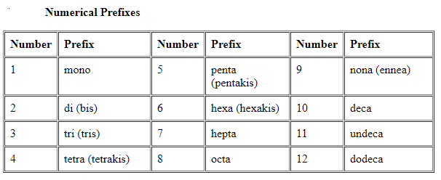

Slide 7
After naming the ligands, name the central metal. If the complex ion is a cation, the metal is named same as the element. For example, Co in a complex cation is call cobalt and Pt is called platinum.
If the complex ion is an anion, the name of the metal ends with the suffix –ate. For example, Co in a complex anion is called cobaltate and Pt is called platinate.
For some metals, the Latin names are used in the complex anions e.g. Fe is called ferrate (not ironate).

Slide 8
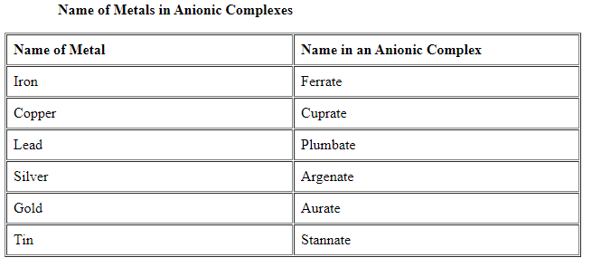

Slide 9
Following the name of the metal, the oxidation state of the metal in the complex is given as a Roman numeral in parentheses.
To name a neutral complex molecule, follow the rules of naming a complex cation.
Remember: Name the cation BEFORE the anion.

Slide 10
1. [Cr(NH₃)₃(H₂O)₃]Cl₃
Answer: triamminetriaquachromium(III) chloride
Solution:
The complex ion is inside the parentheses, which is a cation.
The ammine ligands are named before the aqua ligands according to alphabetical order.
Since there are three chlorides binding with the complex ion, the charge on the complex ion must be +3
From the charge on the complex ion and the charge on the ligands, we can calculate the oxidation number of the metal. In this example, all the ligands are neutral molecules. Therefore, the oxidation number of chromium must be same as the charge of the complex ion, +3.

Slide 11
2. [Pt(NH₃)₅Cl]Br₃
Answer: pentaamminechloroplatinum(IV) bromide
Solution:
The complex ion is a cation, the counter anion is the 3 bromides.
The charge of the complex ion must be +3 since it bonds with 3 bromides.
The NH₃ are neutral molecules while the chloride carries - 1 charge. Therefore, the oxidation number of platinum must be +4.

Slide 12
3. [Pt(H₂NCH₂CH₂NH₂)₂Cl₂]Cl₂
Answer: dichlorobis(ethylenediamine)platinum(IV) chloride
Solution:
ethylenediamine is a bidentate ligand, the bis- prefix is used instead of di-
The ethylenediamine is a neutral molecules while the chloride carries - 1 charge. Therefore, the oxidation number of platinum must be +4.

Slide 13
4. [Co(H₂NCH₂CH₂NH₂)₃]₂(SO₄)₃
Answer: tris(ethylenediamine)cobalt(III) sulfate
Solution:
The sulfate is the counter anion in this molecule. Since it takes 3 sulfates to bond with two complex cations, the charge on each complex cation must be +3.
Since ethylenediamine is a neutral molecule, the oxidation number of cobalt in the complex ion must be +3.
Again, remember that you never have to indicate the number of cations and anions in the name of an ionic compound.

Slide 14
5. K₄[Fe(CN)₆]
Answer: potassium hexacyanoferrate(II)
Solution:
potassium is the cation and the complex ion is the anion.
Since there are 4 K⁺ binding with a complex ion, the charge on the complex ion must be − 4.
Since each ligand carries –1 charge, the oxidation number of Fe must be +2.
The common name of this compound is potassium ferrocyanide.

Slide 15
6. Na₂[NiCl₄]
Answer: sodium tetrachloronickelate(II)
Solution:
The complex ion is the anion so we have to add the suffix –ate in the name of the metal.
Since each ligand carries –1 charge, the oxidation number of Ni must be +2.

Slide 16
7. Pt(NH₃)₂Cl₄
Answer: diamminetetrachloroplatinum(IV)
Solution:
This is a neutral molecule because the charge on Pt⁺⁴ equals the negative charges on the four chloro ligands.
If the compound is [Pt(NH₃)₂Cl₂]Cl₂, eventhough the number of ions and atoms in the molecule are identical to the example, it should be named: diamminedichloroplatinum(II) chloride, a big difference.

Slide 17
8. Fe(CO)₅
Answer: pentacarbonyliron(0)
Solution:
Since it is a neutral complex, it is named in the same way as a complex cation. The common name of this compound, iron carbonyl, is used more often.

Slide 18
9. (NH₄)₂[Ni(C₂O₄)₂(H₂O)₂]
Answer: ammonium diaquabis(oxalato)nickelate(II)
Solution:
The oxalate ion is a bidentate ligand.

Slide 19
10. [Ag(NH₃)₂][Ag(CN)₂]
Answer: diamminesilver(I) dicyanoargentate(I)
You can have a compound where both the cation and the anion are complex ions. Notice how the name of the metal differs even though they are the same metal ions.

